Slide 1




Doing Business with the
U.S. Department of Energy
DOING BUSINESS WITH THE
U.S. DEPARTMENT OF ENERGY
Presented by:
OFFICE OF SMALL AND DISADVANTAGED BUSINESS UTILIZATION
U.S. Department of Energy Office of Economic Impact and Diversity
Minority Business Enterprise Summit
February 23, 2023
http://smallbusiness.energy.gov

Slide 2




History and Mission
DOE/NNSA Sites
DOE Organizational Chart
DOE Budget
OSDBU Mission and Strategic Objectives
DOE’s Small Business Accomplishments
What and How DOE Buys
Subcontracting Opportunities
Tips to Increase Success
Upcoming Events
DOE OSDBU Support
Important Links
Overview
http://smallbusiness.energy.gov

Slide 3
History and Mission
Ensure America’s security and prosperity by addressing its energy, environmental, and nuclear challenges through transformative science and technology solutions.
http://smallbusiness.energy.gov

Slide 4
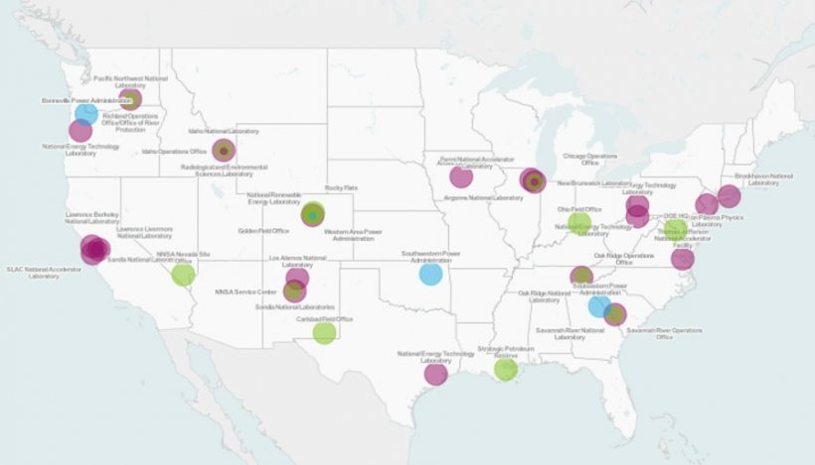
DOE & National Nuclear Security Administration (NNSA) Sites
4
INSERT MAP
http://smallbusiness.energy.gov

Slide 5
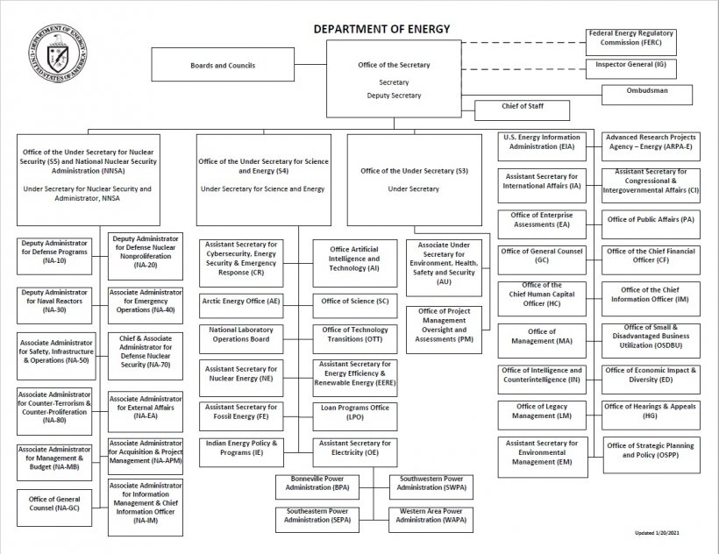
DOE Organization Chart
Organization Chart | Department of Energy
http://smallbusiness.energy.gov

Slide 6
FY 2022 Budgeted Expenditures
http://smallbusiness.energy.gov

Slide 7


OSDBU Mission and Commitment
OUR MISSION
Maximize contract opportunities for small businesses while advancing the Agency’s missions.
OUR COMMITMENT
O: Open the lines of communication through outreach and training.
S: Serve as small business advocates.
D: Deliver useful information.
B: Build public and private industry relationships.
U: Utilize DOE Programs and best practices.
http://smallbusiness.energy.gov

Slide 8
DOE Creates Opportunity for Small Businesses
Total Small Business Obligations (Prime + MOSRC* + Subcontracts)
FY 2015 | $5.7B
FY 2016 | $6.5B
FY 2017 | $6.85B
FY 2018 | $6.16B
FY 2019 | $7.68B
FY 2020 | $8.7B
FY 2021 | $9.7B
FY 2022 | $TBD
Approximately 1 in 4 procurement dollars in DOE goes to Small Businesses
DOE has exceeded its FY22 prime (14%) and subcontracting (49%) small business contracting goals
  To date approximately $8B (still being counted)
  Socioeconomic Category Goal (YTD)
    Small Disadvantaged Business 5% (5.24%)
    Women-Owned SB 5% (3.78%)
    Service-Disabled Veteran-owned SB 3% (1.67%)
    HUBZone SB 3% (1.62%)
Anticipated to earn an “A” Grade from the Small Business Administration (SBA)
Dollars do not include financial assistance spend
FY 2023 prime goal 17%
Individual Scorecard (sba.gov)
http://smallbusiness.energy.gov

Slide 9
Unique Operating Environment
9
Diverse missions, decentralized business model, and complex requirements require a lot of diligence in research and precision in targeting work
2 Senior Procurement Executives
14 Heads of Contracting Activities
80+ Small Business Program Managers
Multiple SBA Procurement Center Representatives
Over 20 Different Acquisition Forecasts
37 Site Facility Management Contracts, including M&Os
Complex Safety, Security and Cybersecurity Requirements
High Cost of Entry
http://smallbusiness.energy.gov
Notes:
.

Slide 10
How DOE Procures & Funds
Full & Open Competition
Full & Open Competition After the Exclusion of Sources (SB Set-asides)
Other than Full & Open Competition (Non-competitive)
Simplified Acquisition Procedures (SAP)
General Service Administration (GSA) Federal Supply Schedules (FSS)
Category Management strategic contracts, Blanket Purchases Agreements (BPAs), Indefinite Delivery Contracts, etc.
Unsolicited Proposals
Funding Opportunity Announcements
Prize Competitions
http://smallbusiness.energy.gov

Slide 11
Areas of Small Business Spend
Top Ten North American Industry Classification System Codes (NAICS)
Small Business Size is determined by Size Standard under each NAICS code
NAICS CODE | NAICS DESCRIPTION
561210 | Facilities Support Services
541611 | Administrative Management and General Management Consulting Services
562910 | Remediation Services
541330 | Engineering Services
541990 | All Other Professional, Scientific, and Technical Services
541620 | Environmental Consulting Services
234930 | Industrial Nonbuilding Structure Construction
541519 | Other Computer Related Services
541512 | Computer Systems Design Services
236220 | Commercial and Institutional Building Construction
http://smallbusiness.energy.gov

Slide 12
Locate Agency Opportunities
  DOE and Major Contractor Acquisition Forecasts: https://www.energy.gov/osdbu/acquisition-forecast
  Provides headquarter prime opportunities
  Provides hyperlinks to the various Agency laboratories for subcontracting opportunities.
  Search each respective site forecast for its unique requirements
  System for Award Management: SAM.gov | Contract Opportunities
  Clean Energy FOAs: Clean Energy Infrastructure Programs at Department of Energy | Department of Energy
  DOE Small Business Innovation Research and Small Business Technology Transfer FOAs: SBIR Funding Opportunity Announc... | U.S. DOE Office of Science (SC) (osti.gov)
  General Services Administration: www.ebuy.gsa.gov/ebuy/
  Federal Grants: www.grants.gov
  DOE Small Business Innovation Research and Small Business Technology Transfer: https://science.energy.gov/sbir/
  Prize Competitions: EERE Competitions, Challenges, and Industry Prizes | Department of Energy
  DOE Unsolicited Proposals: DOE Unsolicited Proposals | netl.doe.gov
http://smallbusiness.energy.gov

Slide 13
Subcontracting Opportunities
DOE Prime Contractors are required to subcontract with SDB, WOSB, SDVOSB, and HUBZone SBs
Approximately 80% of DOE Small Business $ through subcontracts with Prime Contractors
Major DOE Prime Contractors: DOE/NNSA Site Facility Management Contracts | Department of Energy
Supply Chain Management Center (SCMC): Supply Chain Management Center (doe.gov)
Register in site Supplier Registration database, as applicable
Contact site Small Business Program Manager
http://smallbusiness.energy.gov

Slide 14

Mentor-Protégé Program
14
Incubator program to doing business with DOE
Increases participant’s capabilities to better perform and compete for DOE prime contracts and subcontracts
Focused on helping disadvantaged and other socio-economic small businesses, MSI, and HBCUs
Utilizes subcontracting for Protégés’ development
Participation in the DOE MPP is a contractual requirement for many large dollar DOE Facility Management Contracts
For more DOE MPP Info: Mentor-Protégé Program | Department of Energy
SBA MPP: SBA Mentor-Protégé program
http://smallbusiness.energy.gov

Slide 15
Increasing Success
LEVERAGE
- Learn what products and services DOE buys at its different sites
TARGET
- Market/match up your capabilities against DOE/Prime requirements
- Review DOE and Major Contractor acquisition forecasts and SAM.gov
- Ensure socio-economic certifications and security classifications are current
- Stay current with regulations, laws, policy, etc.
- Establish teaming arrangements, joint ventures, etc.
- Pursue low dollar requirements to build past performance
- Pursue all levels of opportunities
- Participate in outreach events
- Adequately respond to Sources Sought/Request for Information/Request for Proposals
- Register in DOE Supplier databases
- Engage SBA, Small Business Development Centers, Procurement Technical Assistance Centers, Minority Business Development Agency,
- Understand and pursue Key DOE Programs like MPP
PREPARE
- Create strong capability statement-
- Engage OSDBU and sites’ Small Business Program Managers
- Join Trade Organizations
- Review DOE OSDBU Small Business Toolbox
http://smallbusiness.energy.gov

Slide 16

Upcoming OSDBU Hosted Events
Mar 28, 2023
WOSB Opportunity Day
Lawrence Livermore National Laboratory (LLNL)
May 3, 2023
HUBZone Opportunity Day
National Energy Technology Laboratory (NETL)
July 11-12, 2023
Morgantown, WV
Livermore, CA
MPP Forum Opportunity Day
Sandia National Laboratory (SNL)
Albuquerque, NM
TBD
OSDBU National SB Forum & Expo
Register today at energy.gov/DOEForum
New Orleans, LA
16
http://smallbusiness.energy.gov

Slide 17
Other Important Links
  U.S. Small Business Administration: Small Business Development Center & SBA Learning Platform
  Procurement Technical Assistance Centers: https://www.aptac-us.org/
  Minority Business Development Centers: MBDA Programs | Minority Business Development Agency
  DOE OSDBU Small Business Toolbox: Small Business Toolbox | Department of Energy
  DOE Acquisition Forecasts: https://www.energy.gov/osdbu/acquisition-forecast
  DOE Small Business Program Managers Directory: https://www.energy.gov/osdbu/articles/small-business-program-managers-directory
  Alleged Undue Restrictions: https://www.energy.gov/osdbu/small-business-services/submit-notice-alleged-undue-restriction
  North American Industry Classification System (NAICS): https://www.census.gov/eos/www/naics
  Federal Grants: www.grants.gov
http://smallbusiness.energy.gov

Slide 18
DOE OSDBU Support
18
For individually-tailored customer care, feel free to contact our office:
  Call: (202) 586-7377
  Email: smallbusiness@hq.doe.gov
  WOSB Program Manager (PM) - Natasha White:
  Natasha.White@hq.doe.gov
  SDVOSB PM – Nicola Ohaegbu: Nicola.Ohaegbu@hq.doe.gov
  HUBZone SB PM – Kent Hibben:
  Kent.Hibben@hq.doe.gov
  Small Disadvantaged Business PM - Mark Lochbaum: Mark.Lochbaum@hq.doe.gov
  Deputy Director SB Programs: Tamara.Miles@hq.doe.gov
http://smallbusiness.energy.gov

